Slide 1

Installing TF1200 TwinCAT 3 UI Client on TC/BSD
Coding Bytes Mini – It’s Me, but the AI version
Versions : TwinCAT BSD 14.2.0.0,2 & TF1200-UI-Client-1.9.2
Notes:
Hello everyone, and welcome to Coding Bytes Mini. These videos are quick simple software tutorials, bought to life by my AI-Powered clone. I write the scripts, and my clone handles the production!
Today we will be installing TF1200, the TwinCAT 3 UI client on TwinCAT BSD.

Slide 2
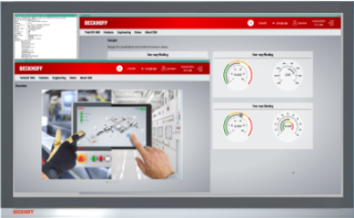
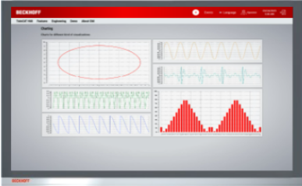
TF1200 TwinCAT 3 UI Client
The UI Client is a cross-platform desktop application which can be used to display web-based HMIs.
Simple to setup, and configurable with a .json file.
Works as both Desktop Application, or Kiosk Mode.
Desktop application
Kiosk Mode
Notes:
The TwinCAT UI Client is a cross-platform desktop application and can be used to display web applications such as the TwinCAT HMI. This replaces the need to install 3rd party web browsers on the system, such as Edge, Chrome or Firefox. The UI client is simple to setup, and configurable with a json file.
It is possible to configure the UI client to work as either a standard desktop application, or a full screen kiosk application which is best suited to machine HMIs.

Slide 3
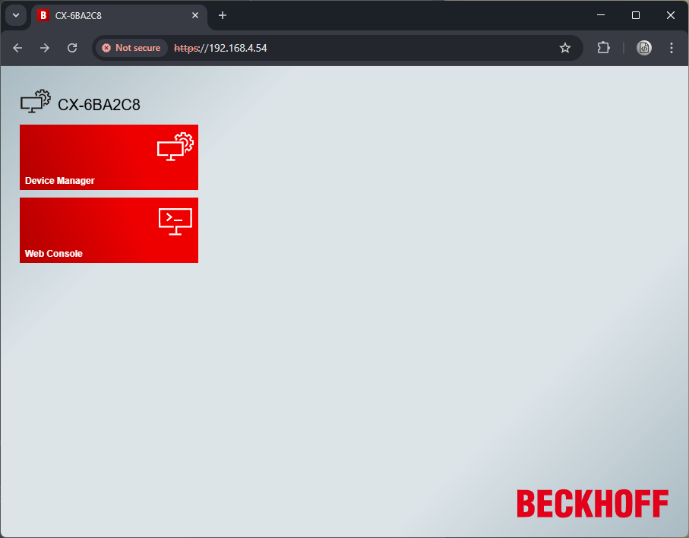
Connecting to the controller
TwinCAT BSD gives you access to web console via the web interface.
This is known as a SSH terminal and is a powerful tool to drive and configure TwinCAT BSD remotely.
Access your controller using https://<ip address>
Click “Web Console” to start the SSH connection
Notes:
In this tutorial we will perform the initial installation and setup remotely. A feature of TwinCAT BSD is its ability to manage the operating system, TwinCAT and any TwinCAT functions via the Web console. The web console has an inbuilt SSH client which can be used to drive TwinCAT BSD as if you were locally connected to it using a monitor and keyboard.
To access your controller, you must first type HTTPS:// then the IP address of your IPC. This will present you with two options. Device manager and web console. Select web console to continue.

Slide 4
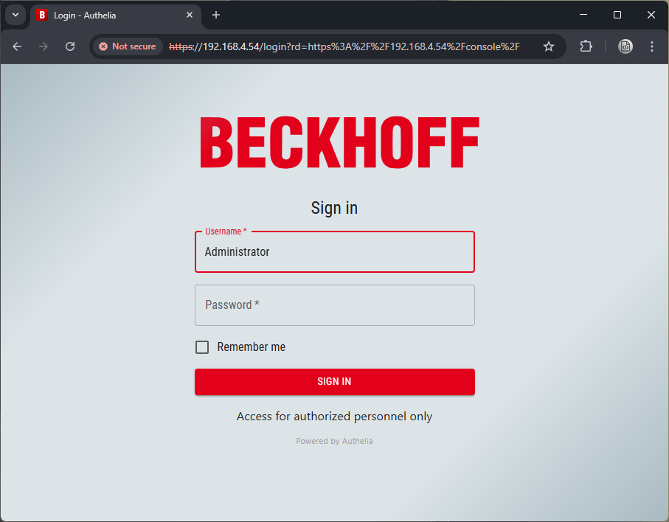
Connecting to the controller
Type in your username and password and press “Sign In”
Typical default credentials are “Administrator” and 1
Notes:
You will be presented with a Sign in page for gaining access to the console. Please type in your username and password. In this example we will use the default credential of Administrator and 1.

Slide 5
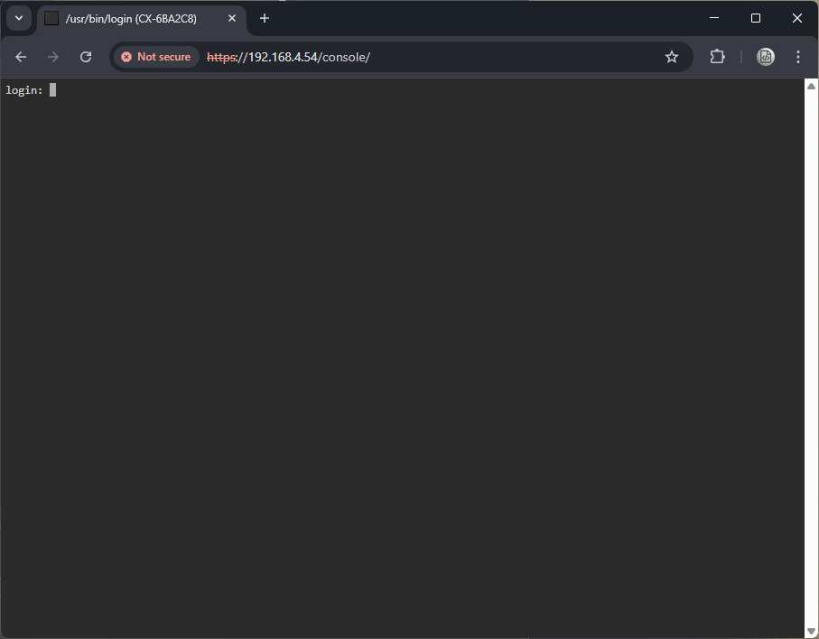
Connecting to the controller
From here we now have control of the IPC as if we were connected to it using a monitor keyboard and mouse.
The terminal is entirely text-based, so it doesn’t support graphical user interfaces. To see a graphical UI, you’ll need to connect a monitor.
INFO
Notes:
You will now be presented with a remote SSH terminal view, which will allow us to perform any administrator actions. Please note, the terminal is entirely text-based, so it does not support graphical user interfaces. To see a graphical UI, you’ll need to connect a monitor.

Slide 6
Login: Administrator
Password:
Last login: Sun Mar 16 22:25:07 on pts/0
FreeBSD 14.2-RELEASE (BHF) n269602-0f771af283a-
The software licenses can be found in this folder: /usr/local/etc/TwinCAT/3.1/System/Legal/
TcOsSys.dll: 4026.14.132
TwinCAT Build: 3.1.4026.0
AMS Net Id: 5.107.162.200.1.1
TC/BSD: 14.2.0.0,2
Administrator@CX-6BA2C8:~ $
We are now connected to TwinCAT BSD via SSH.
Login using your credentials
In this example we will be using the same Administrator and 1 combination
Notes:
Login using your username and password. In this example we shall use the default of Administrator and 1. {pause 1} We will see an overview of the system if we are successful.

Slide 7
Administrator@CX-6BA2C8:~ $ doas pkg install TF1200-UI-Client
Password :
Updating TCBSD repository catalogue...
TCBSD repository is up to date.
All repositories are up to date.
pkg: noto-basic has a missing dependency: noto-sans-symbols2
Checking integrity... done (0 conflicting)
The following 1 package(s) will be affected (of 0 checked):
New packages to be INSTALLED:
TF1200-UI-Client: 1.9.2
Number of packages to be installed: 1
The process will require 389 MiB more space.
Proceed with this action? [y/N]: y
To install TF1200, use the following command.
doas pkg install TF1200-UI-Client
Then confirm using y to continue.
Notes:
Next, we shall use the command doas pkg install TF1200-UI-Client. {pause 0.5} After pressing enter you will see an overview of what will be installed. Press the letter Y on the keyboard to continue.

Slide 8
[1/1] Installing TF1200-UI-Client-1.9.2...
[1/1] Extracting TF1200-UI-Client-1.9.2: 100%
=====
Message from TF1200-UI-Client-1.9.2:
--
Run the following command for more information about setting up and
configuring TF1200-UI-Client:
man TF1200-UI-Client
Administrator@CX-6BA2C8:~ $
The package manager will now install TF1200 to your system.
Once complete you will have a message to say, use man TF1200-UI-Client to configure your client.
This command will open the manual for the software and is not required for this tutorial.
Notes:
The installation will now take place. Once complete it will inform you that the man command can be used to open the manual. This can be skipped for this tutorial.

Slide 9
Administrator@CX-6BA2C8:~ $ cd /usr/local/etc/TwinCAT/Functions/TF1200-UI-Client/scripts
Administrator@CX-6BA2C8:/usr/local/etc/TwinCAT/Functions/TF1200-UI-Client/scripts $
Once done, we will now gain access to pre-made scripts.
Use the cd command below to navigate to the folder.
cd /usr/local/etc/TwinCAT/Functions/TF1200-UI-Client/scripts
Notes:
TF1200 install includes pre-made scripts to assist with setting up the software. Use the cd command as shown to change to the folder.

Slide 10
HINT
Administrator@CX-6BA2C8:/usr/local/etc/TwinCAT/Functions/TF1200-UI-Client/scripts $ ls
backgrounds setup-autostart.sh setup-full.sh setup-sway.sh
setup-autologin.sh setup-default-config.sh setup-sway-config.sh
Administrator@CX-6BA2C8:/usr/local/etc/TwinCAT/Functions/TF1200-UI-Client/scripts $ ./setup-autostart.sh --help
USAGE: setup-autostart.sh
Sets up autostart for the Sway Compositor after login. Use this script
together with setup-autologin.sh to automatically log in the specified user
and start the Sway Compositor after the system boots.
Administrator@CX-6BA2C8:/usr/local/etc/TwinCAT/Functions/TF1200-UI-Client/scripts $
To list the content of a folder, use the ls command
You can see the use of each script by using the --help flags
For example,
./setup-autostart.sh --help
Notes:
As a handy hint, you can use the l s command to show a list of all of the scripts located in the folder. {pause 0.5}
You can see details about each of the scripts by including the help flag at the end of the file name as shown.

Slide 11
Administrator@CX-6BA2C8:/usr/local/etc/TwinCAT/Functions/TF1200-UI-Client/scripts $ doas ./setup-full.sh --user=TF1200 --autologin –autostart
Password:
seatd_enable: -> YES
kld_list: -> i915kms
Starting seatd.
Administrator@CX-6BA2C8:/usr/local/etc/TwinCAT/Functions/TF1200-UI-Client/scripts $
We are going to use the command
doas ./setup-full.sh --user=TF1200 --autologin --autostart
This will perform a standard setup.
Setup a TF1200 user
Sets auto login
Sets auto start
Notes:
We are now ready to setup TF1200 using a default configuration. Type in the command above. This will create a new TF1200 user. It will set the system to automatically login this user, and once logged in, it will start the TF1200 UI client automatically.

Slide 12
Administrator@CX-6BA2C8:/usr/local/etc/TwinCAT/Functions/TF1200-UI-Client/scripts $ shutdown -r now
We are ready to try out our installation.
Connect a keyboard, mouse and monitor to your IPC.
Reboot TwinCAT BSD using the shutdown command.
shutdown –r now
Notes:
This is the installation of TF1200 complete. We will now connect a keyboard, mouse and monitor to the IPC and reboot. You can use the shutdown command as shown above to reboot from the terminal.

Slide 13

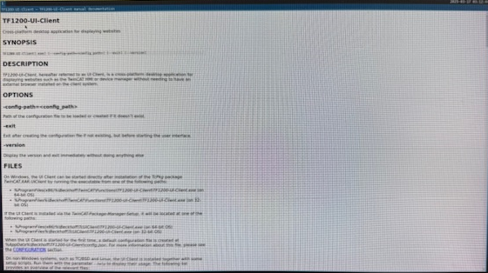
TF1200 Configuration
On the monitor attached to the IPC, you will see TwinCAT BSD boot into the TF1200 client default screen.
Next step is to configure TF1200.
We will use web console for this too.
Notes:
You will now see TwinCAT BSD booting directly into the TF1200 UI client. By default, this will show the documentation. The next step is to use the web console to configure the software to point to our local TwinCAT HMI server.

Slide 14
Login: TF1200
Last login: Mon Mar 17 03:17:03 on pts/0
FreeBSD 14.2-RELEASE (BHF) n269602-0f771af283a-
The software licenses can be found in this folder: /usr/local/etc/TwinCAT/3.1/System/Legal/
TcOsSys.dll: 4026.14.132
TwinCAT Build: 3.1.4026.0
AMS Net Id: 5.107.162.200.1.1
TC/BSD: 14.2.0.0,2
00:00:00.005 [wlr] [libseat] [libseat/backend/seatd.c:311] Could not poll connection: Broken pipe
00:00:00.005 [wlr] [libseat] [libseat/libseat.c:83] No backend was able to open a seat
00:00:00.005 [wlr] [backend/session/session.c:83] Unable to create seat: Function not implemented
00:00:00.005 [wlr] [backend/session/session.c:248] Failed to load session backend
00:00:00.005 [wlr] [backend/backend.c:79] Failed to start a session
00:00:00.005 [wlr] [backend/backend.c:407] Failed to start a DRM session
00:00:00.006 [sway/server.c:228] Unable to create backend
TF1200@CX-6BA2C8:~ $
Next, we will login using the TF1200 user.
This user is configured with no password.
Notes:
As before, open the web console using the Administrator credentials. This time, on the terminal we will login using the newly created user TF1200, with no password.

Slide 15
TF1200@CX-6BA2C8:~ $ ee /home/TF1200/.config/TF1200-UI-Client/config.json
^u end of file ^a begin of line ^w delete word ^b back 1 char ^z next word
^t top of text ^e end of line ^r restore word ^f forward char
^c command ^d delete char ^j undelete char ESC-Enter: exit
=====line 1 col 0 lines from top 1 ============================================
{
"allowMove": true,
"allowResize": true,
"autoUpdateConfig": true,
"commandLineSwitches": [],
"configVersion": "1.9",
"defaultTheme": "",
"enableDevTools": true,
"enableIncognitoMode": true,
"enableKioskMode": false,
"enableMenuBar": false,
"extensions": {},
"historyGoBackKeys": "Alt+Left",
"historyGoForwardKeys": "Alt+Rig
TF1200 UI Client is configured using the config.json file found here…
/home/TF1200/.config/TF1200-UI-Client/config.json
We will use EasyEditor make changes.
Type ee followed by the full path to open the file.
ee /home/TF1200/.config/TF1200-UI-Client/config.json
You will see the file open for editing.
Notes:
The TF1200 UI client is configured using a json file. The path is shown on the slide. We will use e e, which is the Easy Editor pre-installed in TwinCAT BSD to edit the file. Type e e, followed by the file path to open the editor. The editor is text base, so at the top of the file they show common useful commands.

Slide 16
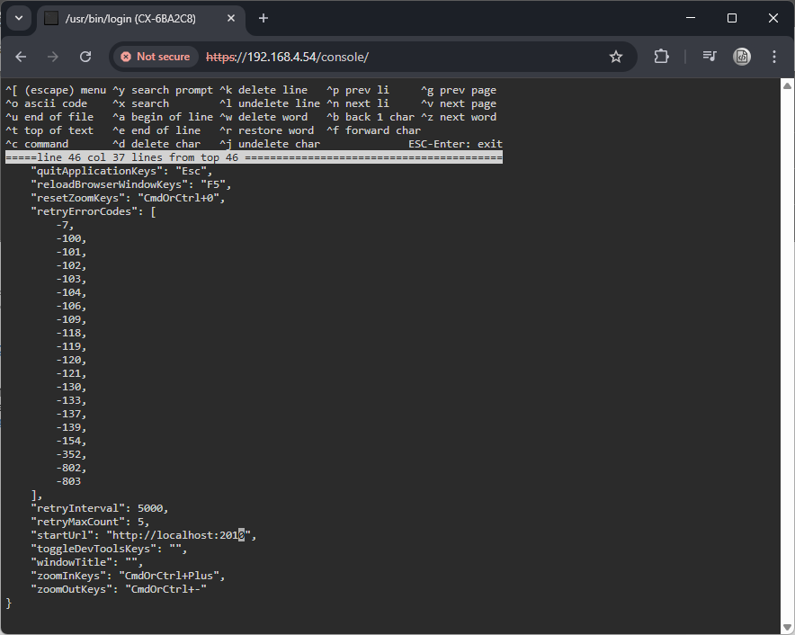
Use the arrow keys to find the “startUrl” entry.
Modify the line so that it points to the URL of your HMI server.
The default URL for TwinCAT HMI is… http://localhost:2010
Notes:
The editor is very easy to use. Simply navigate the file using the arrow keys. We need to find and edit the start url entry. We will change this to http colon, forward slash, forward slash, local host, colon 20 10. This document is a json format, so take care when editing the file to preserve the correct speech marks and commas.

Slide 17
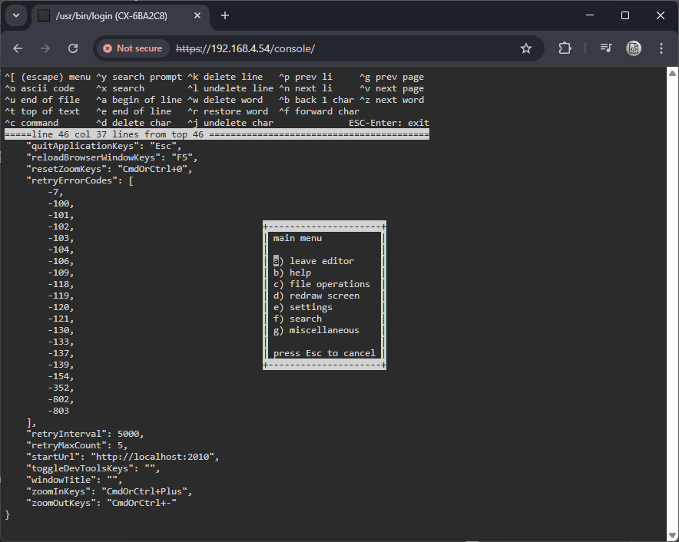
To complete the change, press esc to open the exit menu
Then press A to leave the editor.
Notes:
Press escape to open the main menu. Press “a” to leave the editor.

Slide 18
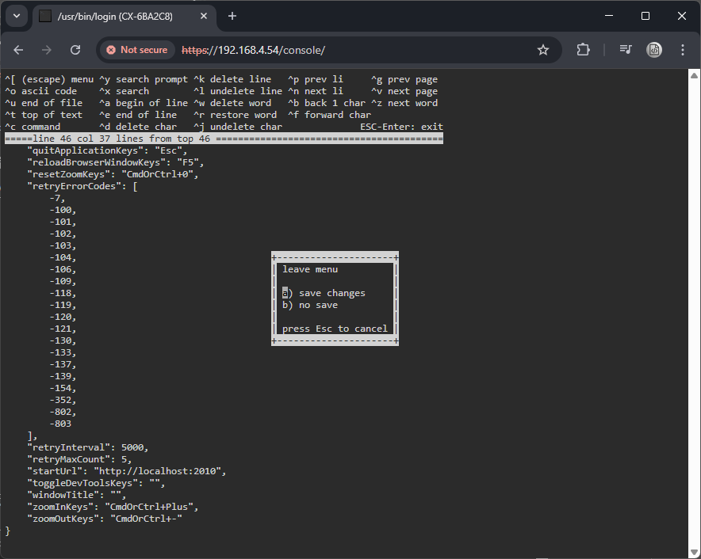
Press A once more to save changes and return to the terminal.
Notes:
Now select “a” once again to save changes.

Slide 19

TF1200 Setup Complete
You can now power cycle your IPC to test the final configuration.
The TF1200 will automatically load and shall display the start URL.
Notes:
You can now test your system by restarting your IPC. TwinCAT BSD will load, the TF1200 user will automatically log on and the UI client will auto start with the configured URL.

Slide 20
Notes:
That’s it for this Coding Byte Mini! I hope you found this video of use. I create these videos using my AI clone, to speed up content production while still keeping everything scripted by me. My goal is to make coding insights quick and accessible. If you found this helpful—or have any feedback—let me know! Your thoughts help shape future videos. See you in the next one!

